Slide 1
Canada provinces and cities
Data Analysis performed by
Joel Sandé

Slide 2
Preface
Data of theses stats have been drawn from:
http://www.downloadexcelfiles.com/wo_en/download-list-cities-canada#.WpmQS-jOWM8
For more information, please visit : www.downloadexcelfiles.com

Slide 3
Preface
I want this powerpoint, highlight, from a practical case, the power of analysis of the Python language and its ability to generate results in visual form.
I will leave a link to download the csv file from where the data is drawn. The code will be available upon request from sandejoel@yahoo.ca
(Free if you are a student taking my course, or a government representative).

Slide 4
Overview
Introduction
Analysis Methodology
Small requests
Complex requests
Conclusion

Slide 5
Analysis Methodology
By habit, I like to make small queries (Functions) for warm-up: So we will start with this one.
In general, when these queries are established, for the future, when we have to do with larger queries, just go search them one by one or even combine them to facilitate the task during a large query .
It becomes child's play, and the code is easier to maintain. We will see in the end a case where this is not necessary.
Here we go …

Slide 6
Canada's 10 Most Populated Cities in 2011 with their respective populations.

Slide 7
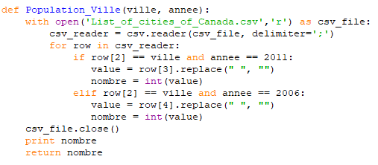
Small Requests
The population of a city for a given year
Population_Ville('Calgary', 2006)
The python`s answer is 988812

Slide 8
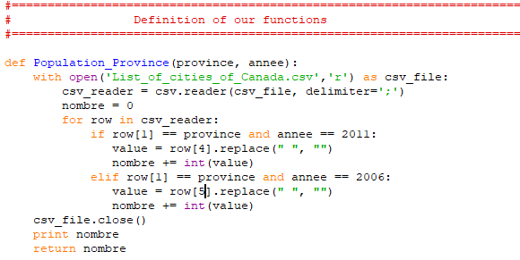
Petite Requête
The population of a province for a given year
Population_Province('Alberta', 2011)
The python`s answer is 2207686

Slide 9
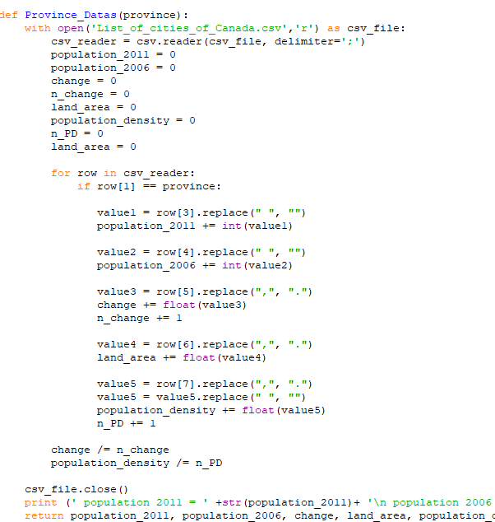
Petite Requête
Collect all data from a province
Province_Datas('Alberta')
population 2011 = 2473572
population 2006 = 2207686
change = 18.7166666667
land area = 2335.86
population density =
756.622222222

Slide 10
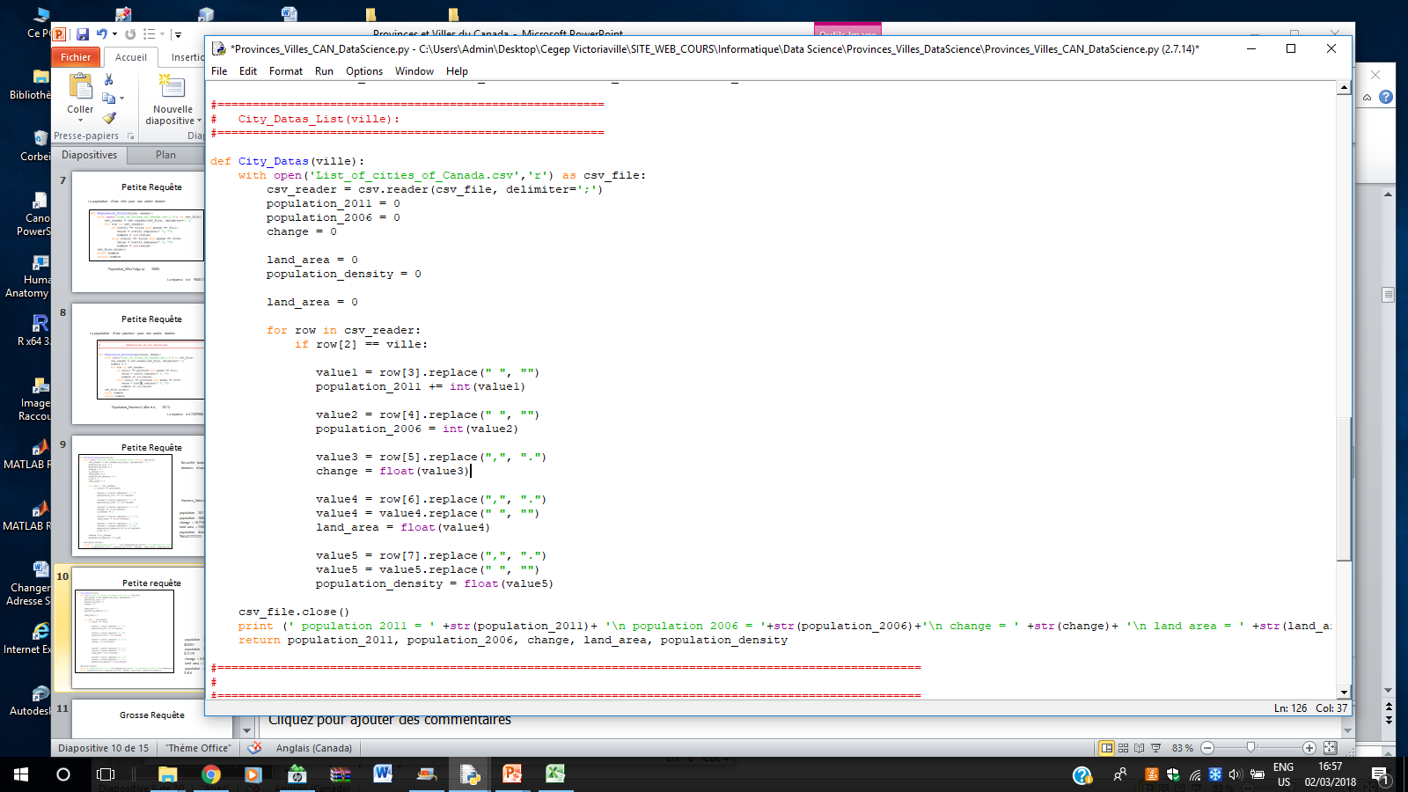
Small requests
Collect all data from a city
population 2011 = 883391
population 2006 = 812129
change = 8.8
land area = 2790.22
population density = 316.6

Slide 11
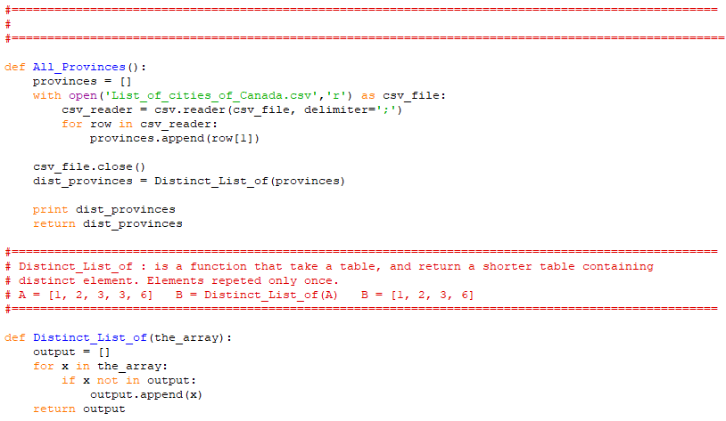
Petite Requête
Collect all provinces names
Small function that serves me to make a separate selection.
NB: This function is not necessary in the recovery of the names of cities because there is no repetition

Slide 12
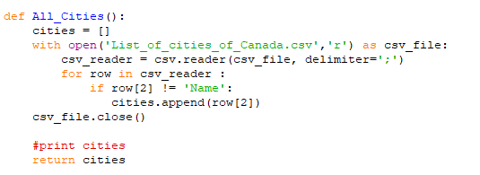
Petite Requête
Collect all cities names

Slide 13
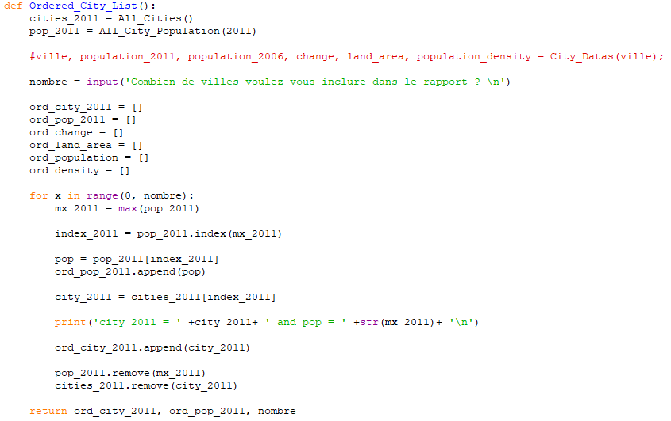
Grosses Requêtes
Statistics for Canada's 10 Most Populous Cities:
In this function, I chose to put out the names of the cities and their respective populations. The great difficulty of this function is in the FOR loop

Slide 14
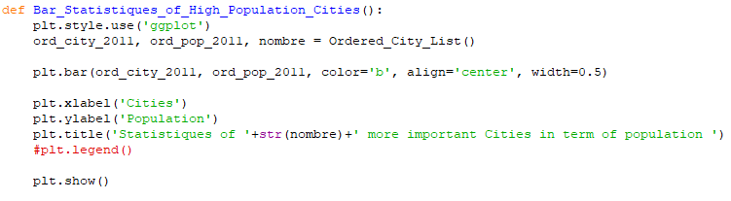
Visualization

Slide 15
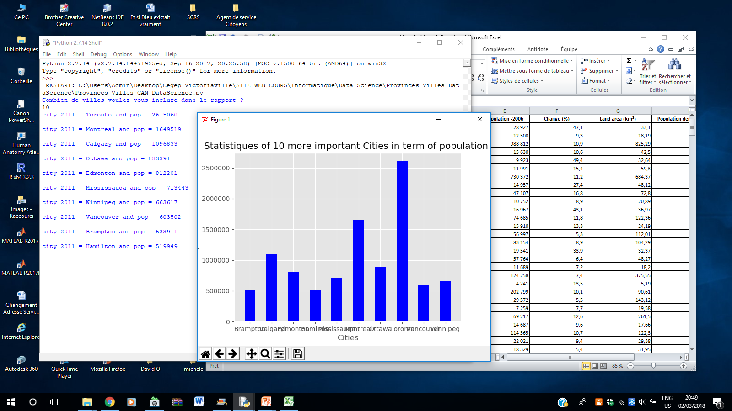
Grosse Requête
Les 10 villes les plus peuplées du Canada en 2011 avec leurs populations respectives

Slide 16
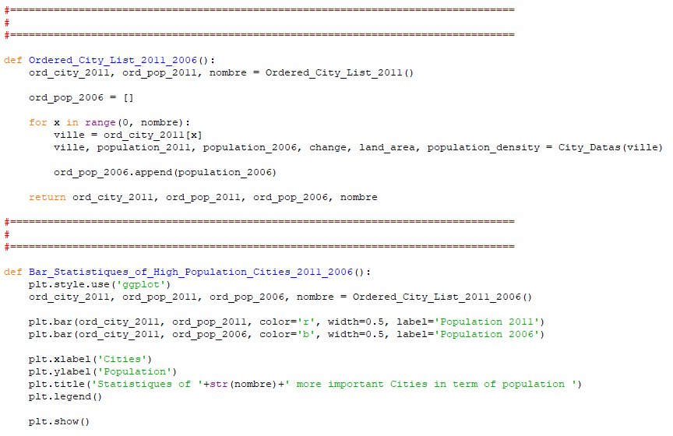
A small and smart manipulation is needed to perform the following request

Slide 17
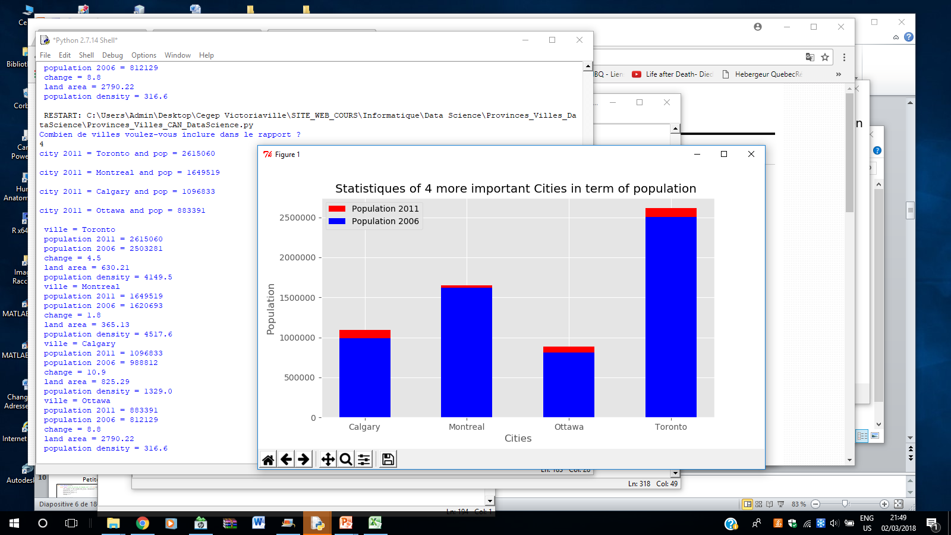
Complex request
Statistics for Canada's 4 Most Popular Cities

Slide 18
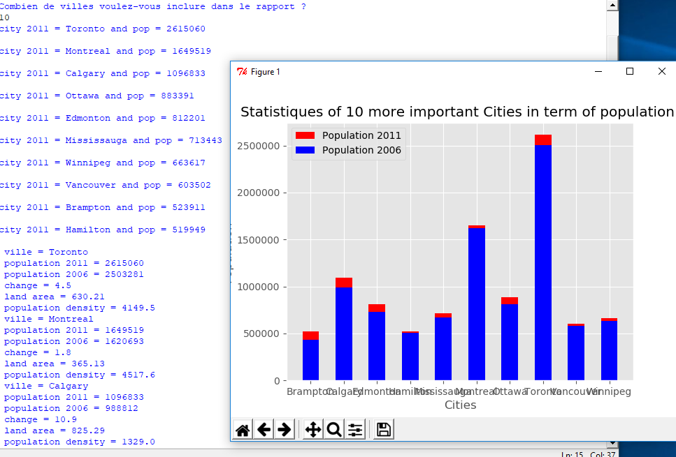
Complex Request

Slide 19
Conclusion
Populations continue to grow and grow.

